Slide 1
Process Scheduling

Slide 2
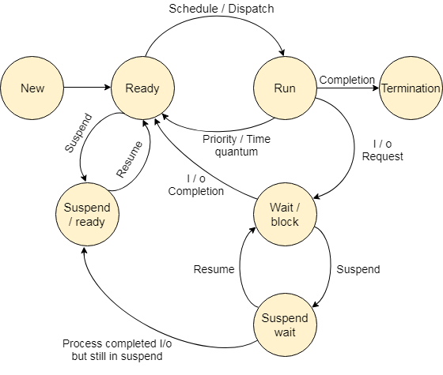
Process State Transition Diagram

Slide 3
CPU Scheduler
A process migrates between the various scheduling queues throughout its lifetime.
The OS must select, for scheduling purposes, processes from these queues in some fashion.
The selection process is carried out by the appropriate schedulers

Slide 4
Types of Schedulers
Long Term Scheduler
Selects processes that are ready to execute and loads them into ready queue.
Short Term Scheduler
Selects process from the ready queue and allocates CPU to it
Medium Term Scheduler
Selects which swapped out process is to be loaded next into the ready queue

Slide 5
Dispatcher
The dispatcher is the module that gives control of the CPU to the process selected by the short term scheduler.
ST → Dispatcher→running

Slide 6
Scheduling Criteria
Arrival Time: When a process enters in a ready state
Burst Time/Execution Time: It is the time required by the process to complete execution. It is also called running time.
Completion Time: When process complete and exit from a system
Turn Around Time : The interval from time of submission of a process to time of completion. TAT=CT-AT

Slide 7
Scheduling Criteria
Waiting Time: Time spent by a process waiting in the ready queue.
WT = TAT – Burst Time.
Response Time : The time taken from submission of the process of request until the first response is produced.

Slide 8
Scheduling Criteria
CPU Utilization
Keep the CPU as busy as possible.
Throughput
Number of processes that are completed per unit time
Maximize – CPU Utilization & Throughput
Minimize – TAT, WT, RT
Fair Allocation of CPU to processes.

Slide 9
CPU Scheduling
CPU scheduling deals with the problem of deciding which of the processes in the ready queue is to be allocated the CPU.
There are many different CPU scheduling algorithms are there.

Slide 10
CPU Scheduling
Short Term Scheduler
Ready to Running
Calls when Process moves from
Running -> ready
Running -> Termination
Running -> Wait

Slide 11
Pre-emptive & Non Pre-emptive Scheduling
Under non preemptive scheduling, once the CPU has been allocated to a process, the process keeps the CPU until it releases the CPU either by terminating or by switching to wait state.
A scheduling is said to be Preemptive, when a process returns the CPU if its time slice is over.

Slide 12
FCFS (First Come First Serve)
Mode: Non Pre-emptive / Criteria: Arrival time
The process requests the CPU first is allocated the CPU first .
The implementation can be easily managed by maintaining a FIFO list.
When a process enters the ready queue, its PCB is linked onto the tail of the queue.
The running process is removed from the queue. When the CPU is free, it is allocated to the process at the head of the queue.

Slide 13
FCFS (First Come First Serve)
PNO | AT | BT | CT | TAT | WT
1 | 0 | 4
2 | 1 | 3
3 | 2 | 1
4 | 3 | 2
5 | 4 | 5
TAT = CT – AT
WT= TAT - BT
Average TAT
Average Waiting Time:
If more processes with same arrival time , then it will take the process with smaller PID

Slide 14
FCFS (First Come First Serve)
PID | AT | BT | CT | TAT | WT
1 | 0 | 40
2 | 1 | 3
3 | 1 | 1
Average TAT
Average Waiting Time:

Slide 15
FCFS (First Come First Serve)
FCFS suffers from Convoy effect.
Shorter processes get stuck waiting behind longer processes
Inefficient use of system resources.
Increased waiting times for all processes.
The average waiting time is much higher than the other algorithms.
FCFS is very simple and easy to implement but efficient.

Slide 16
Shortest job first (SJF) – Non preemptive
When the CPU is available, it is assigned to the process that has the smallest next CPU burst.
If two processes have the same length next CPU burst, FCFS scheduling is used to break the tie.
Objective is to minimize the average waiting time by prioritizing shorter processes over longer ones.

Slide 17
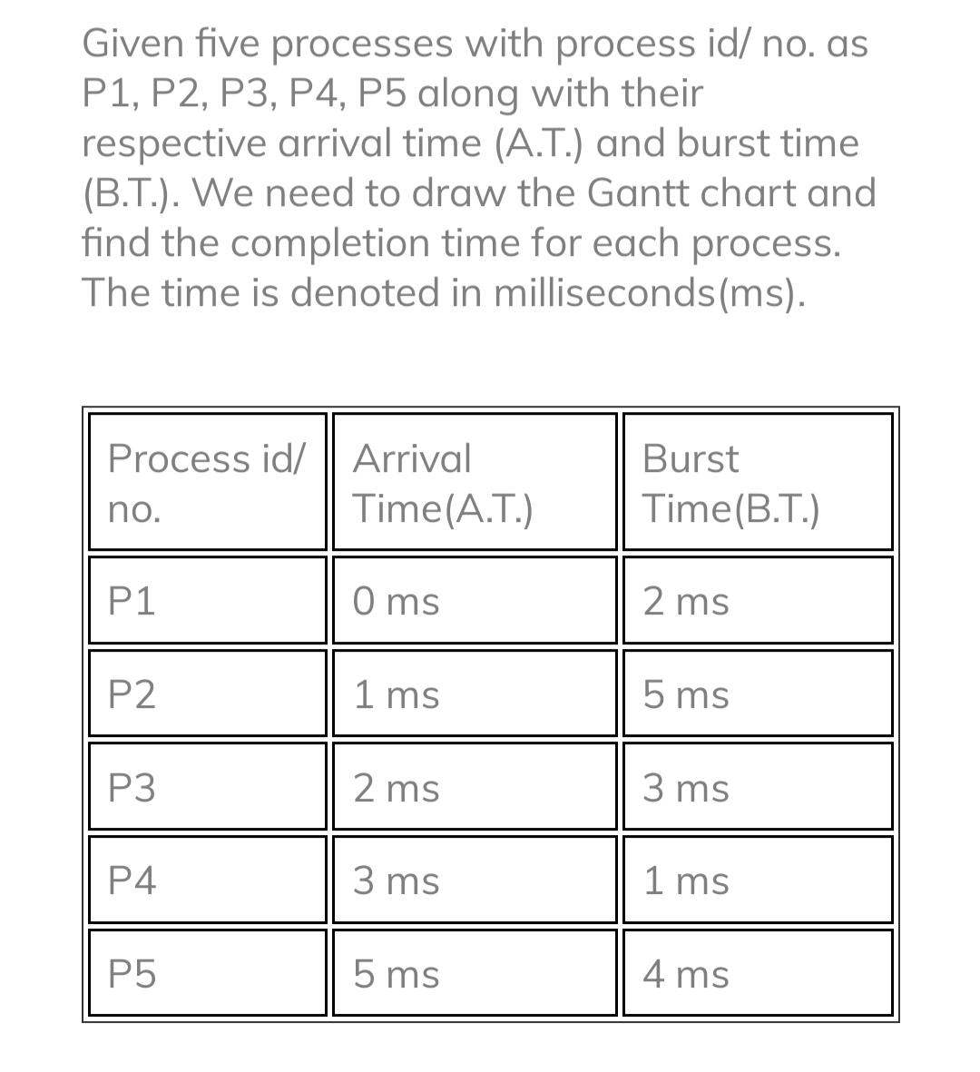
Sjf – non preemptive

Slide 18
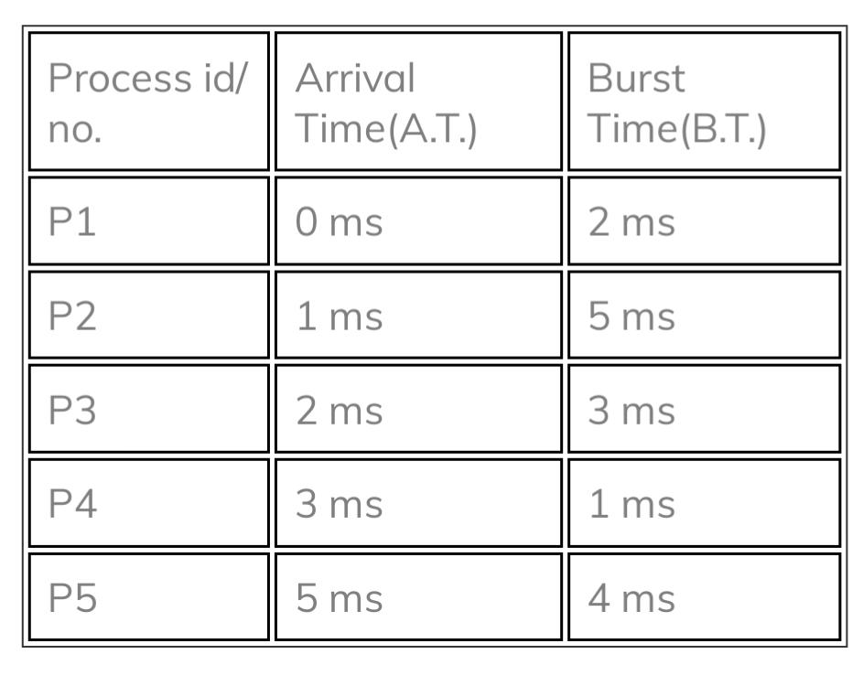
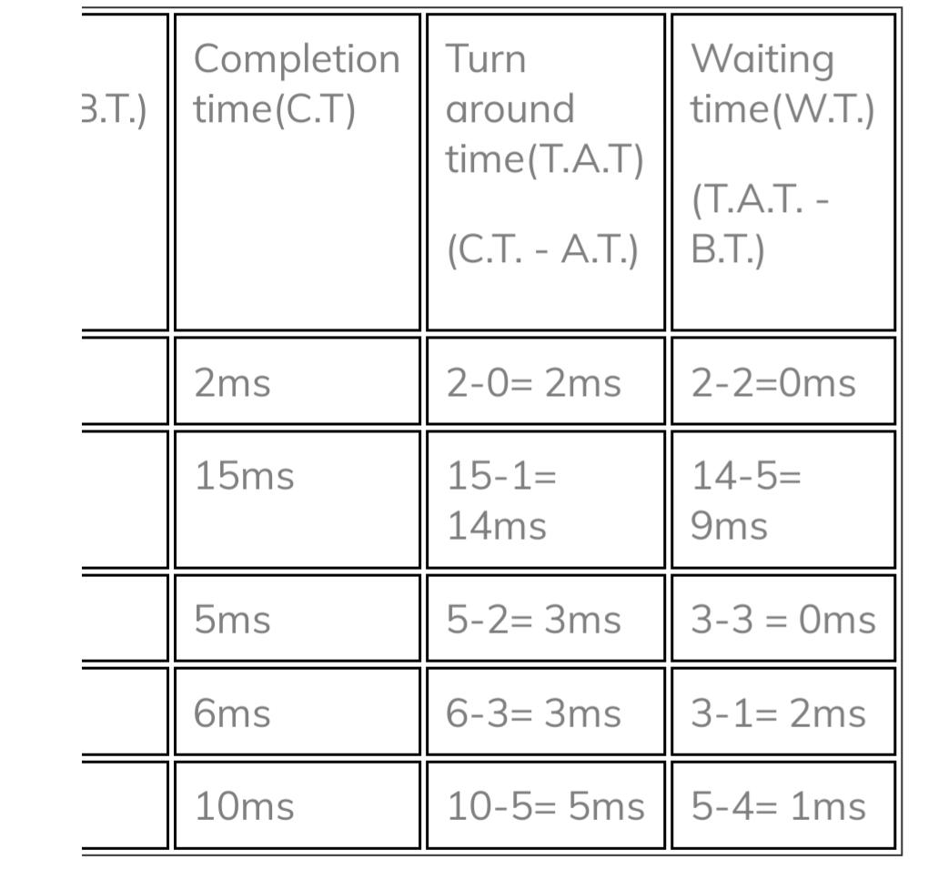
Sjf – non preemptive

Slide 19
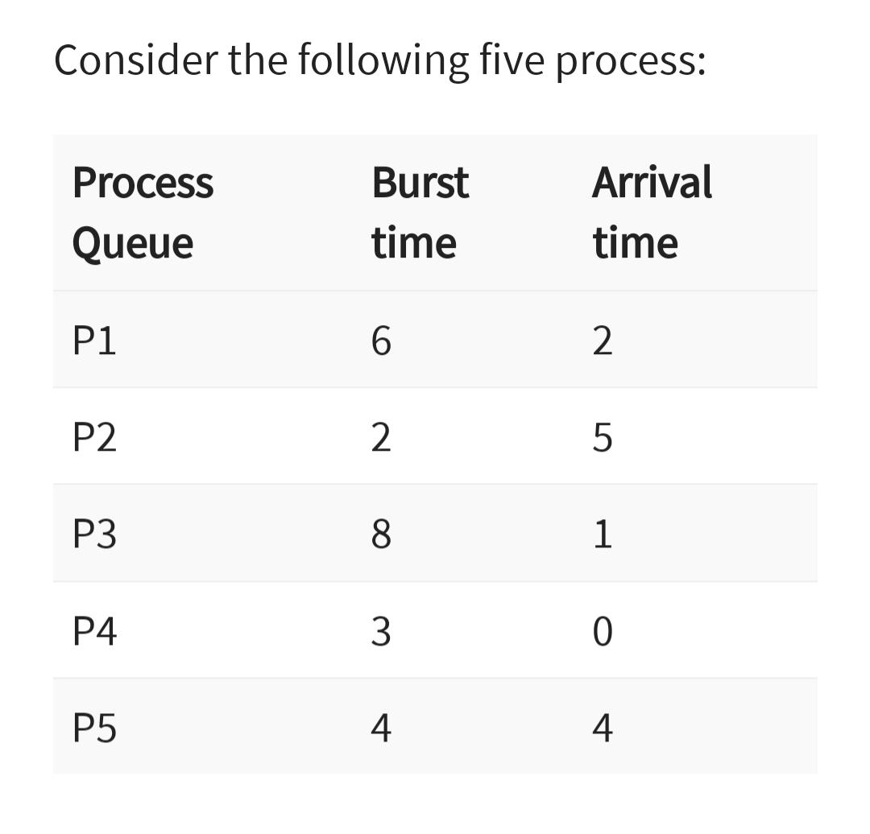
Sjf - preemptive

Slide 20
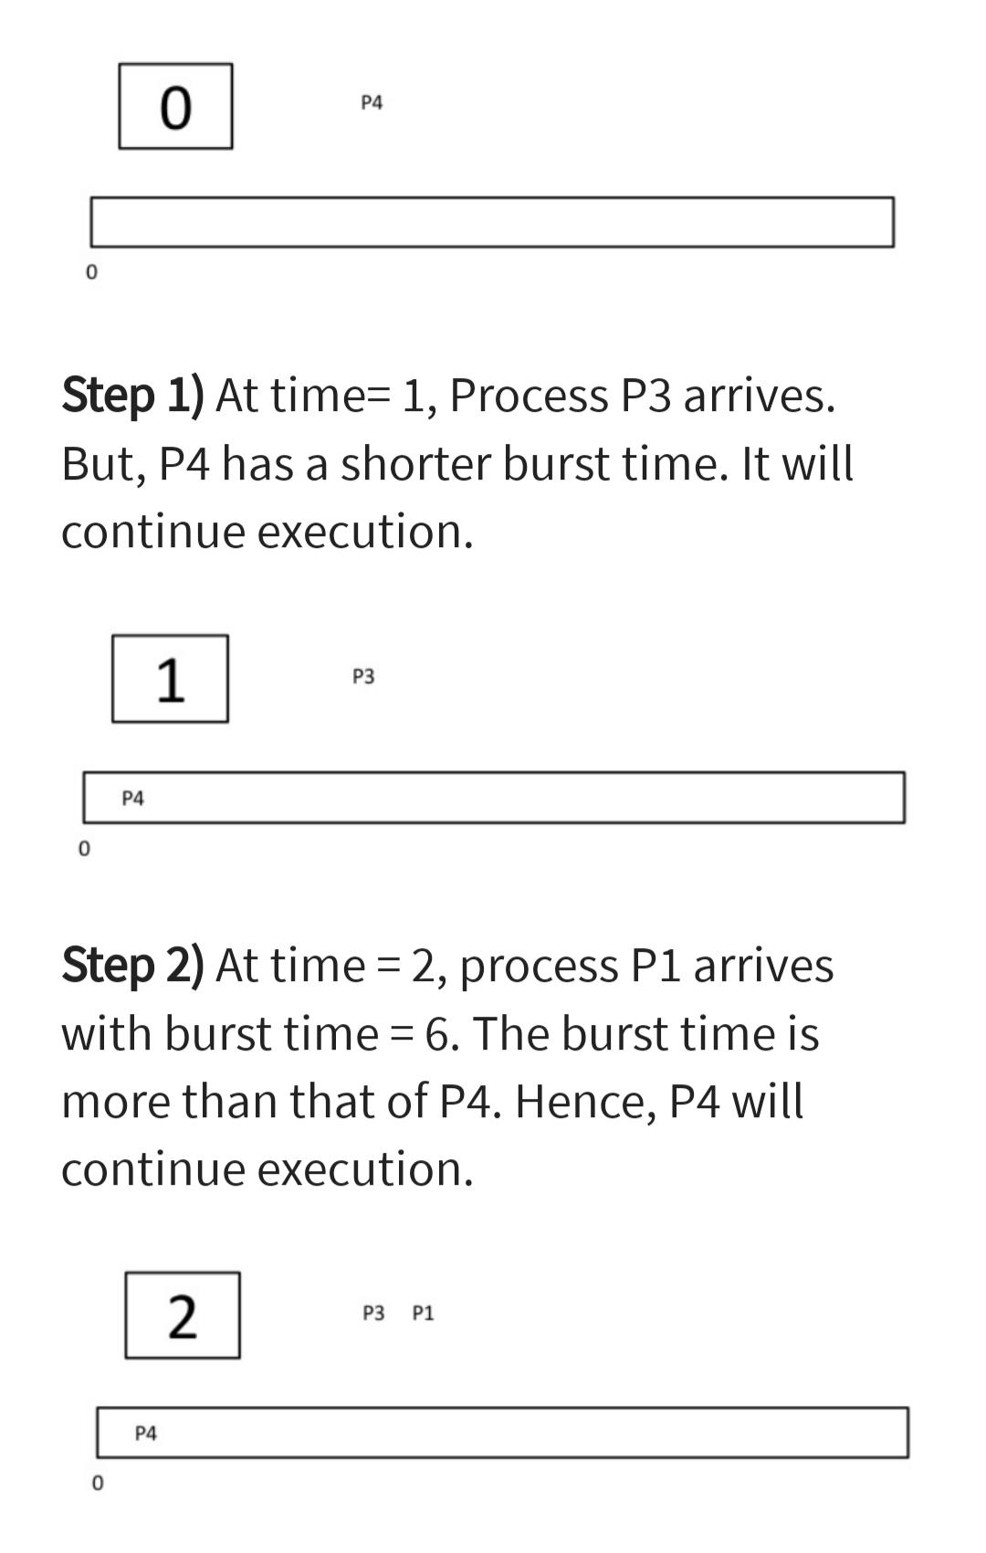
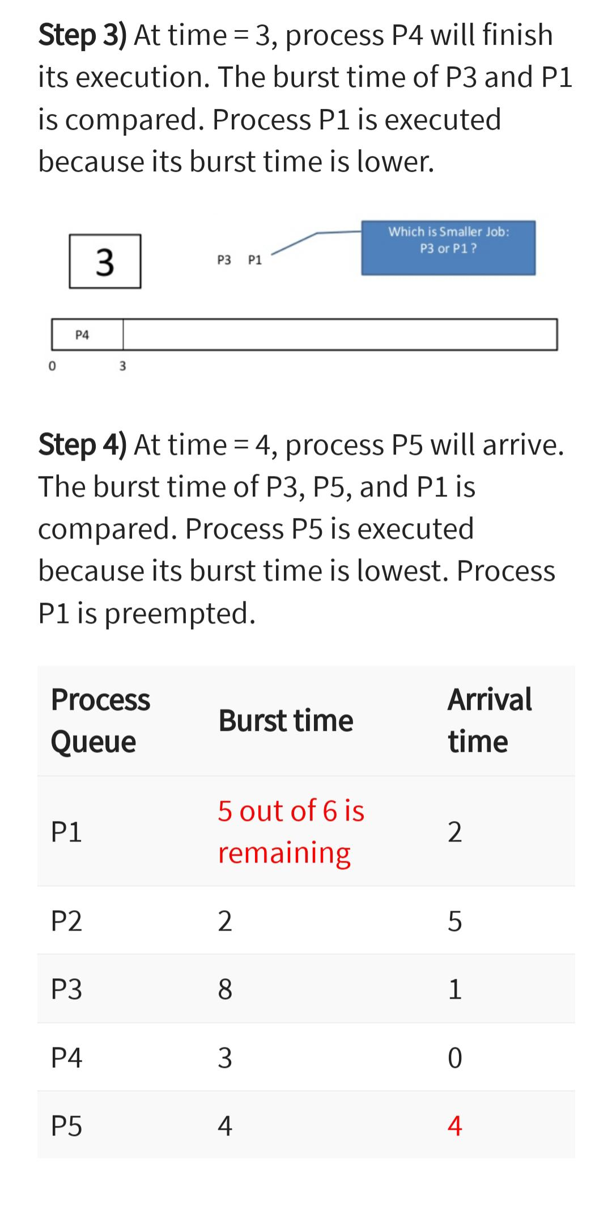

Slide 21
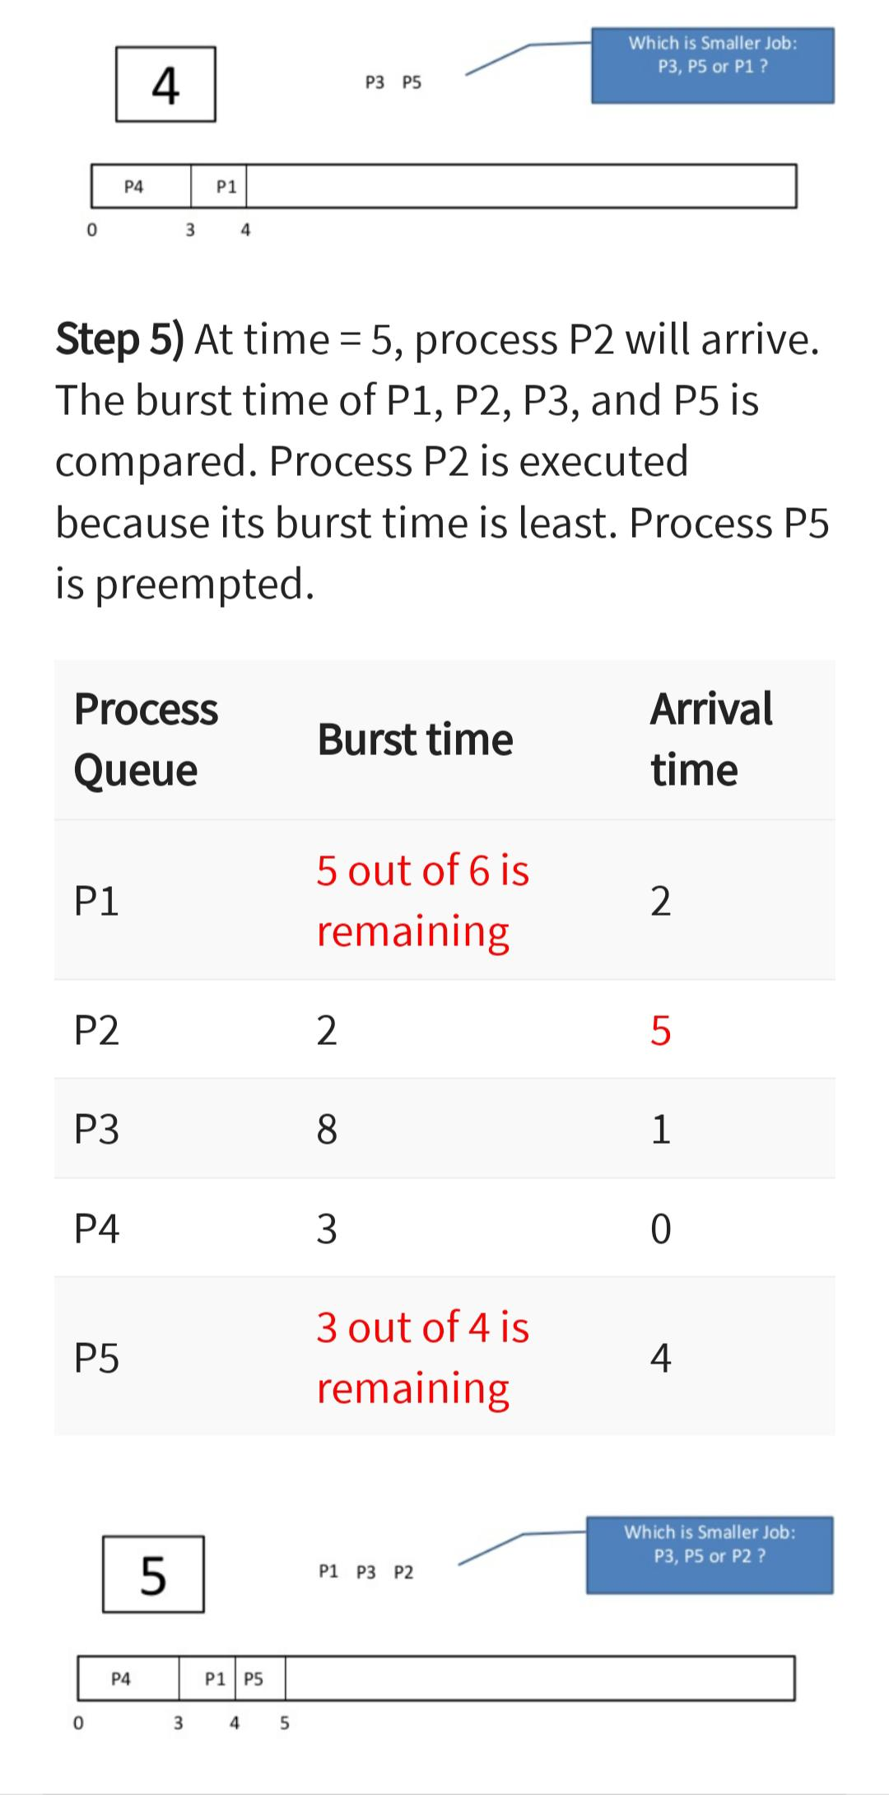
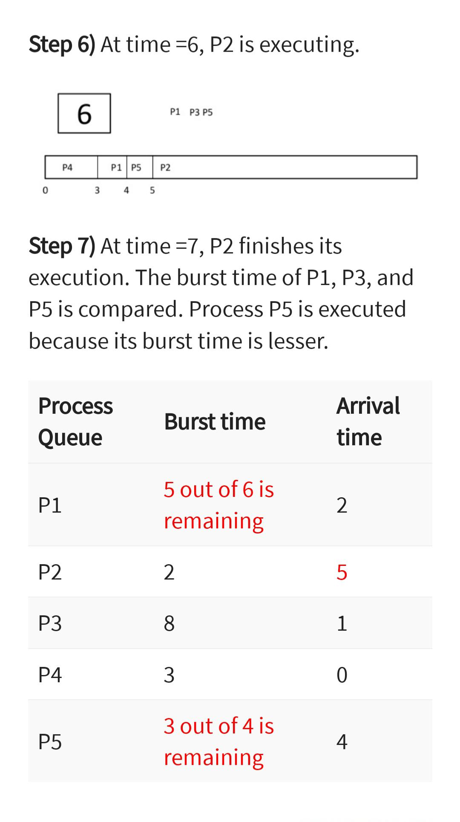

Slide 22
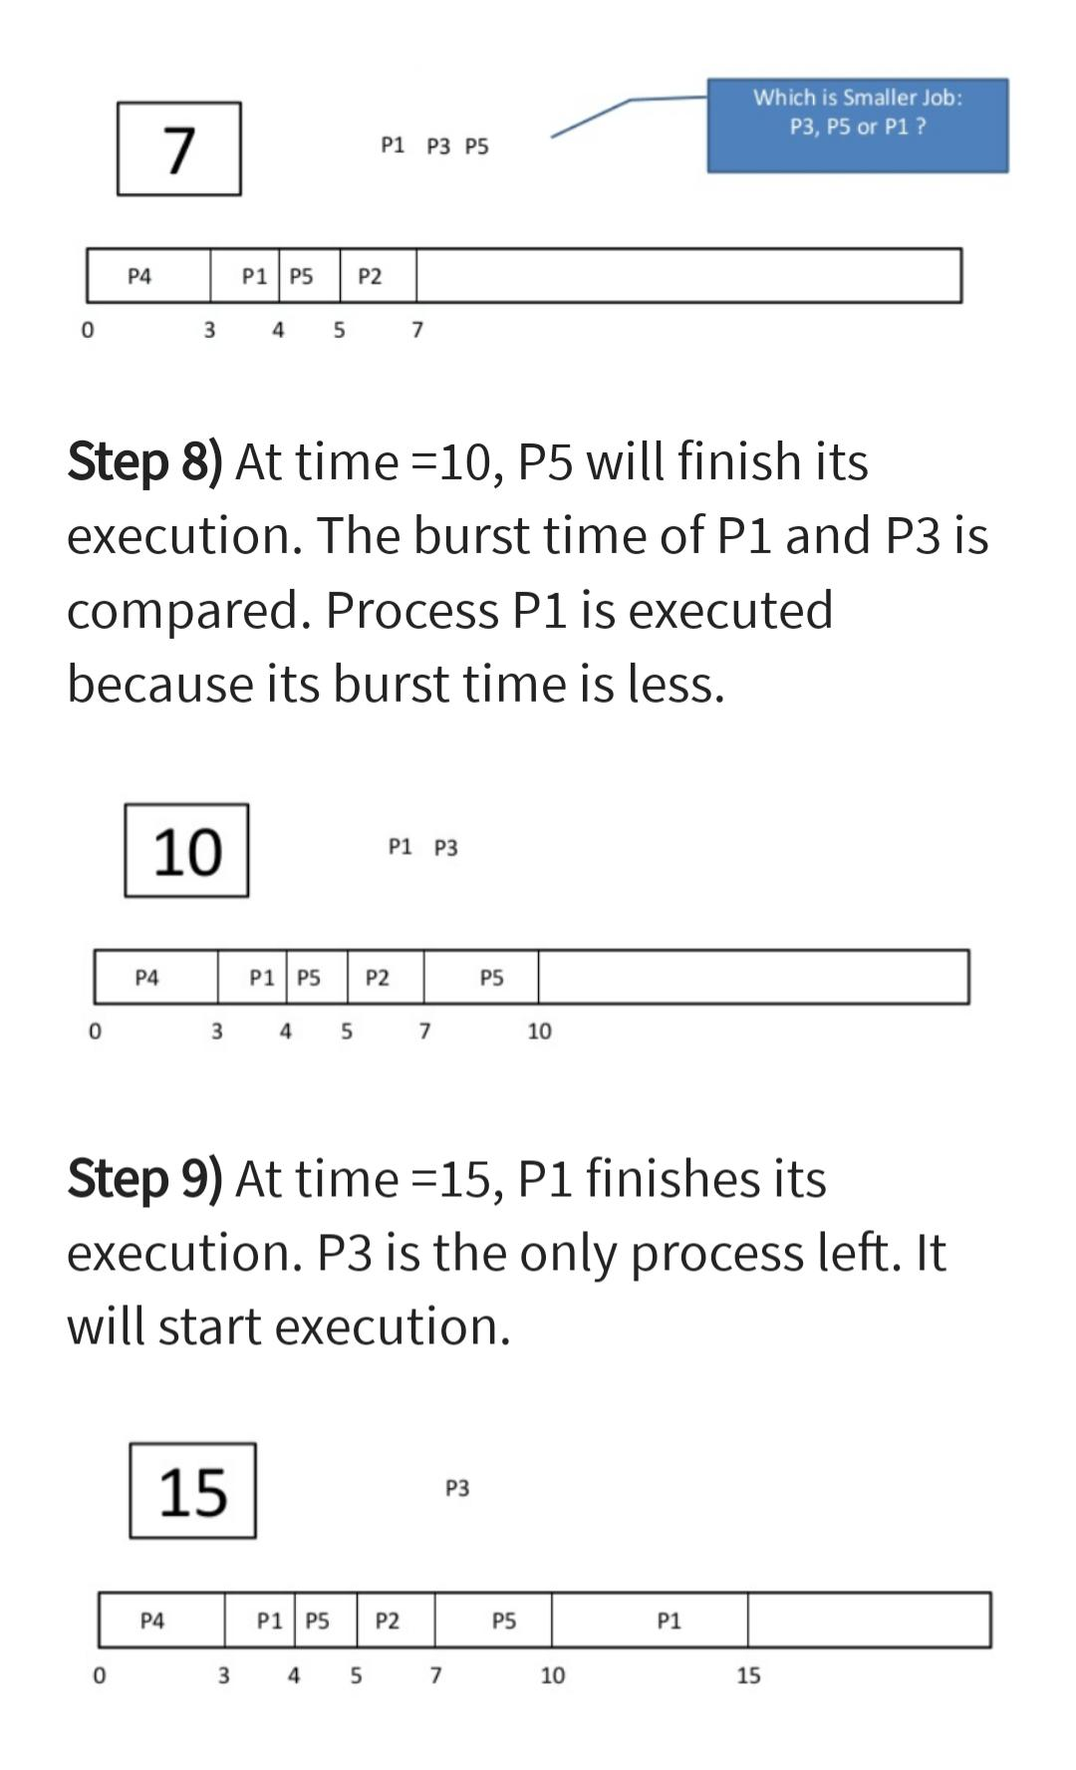
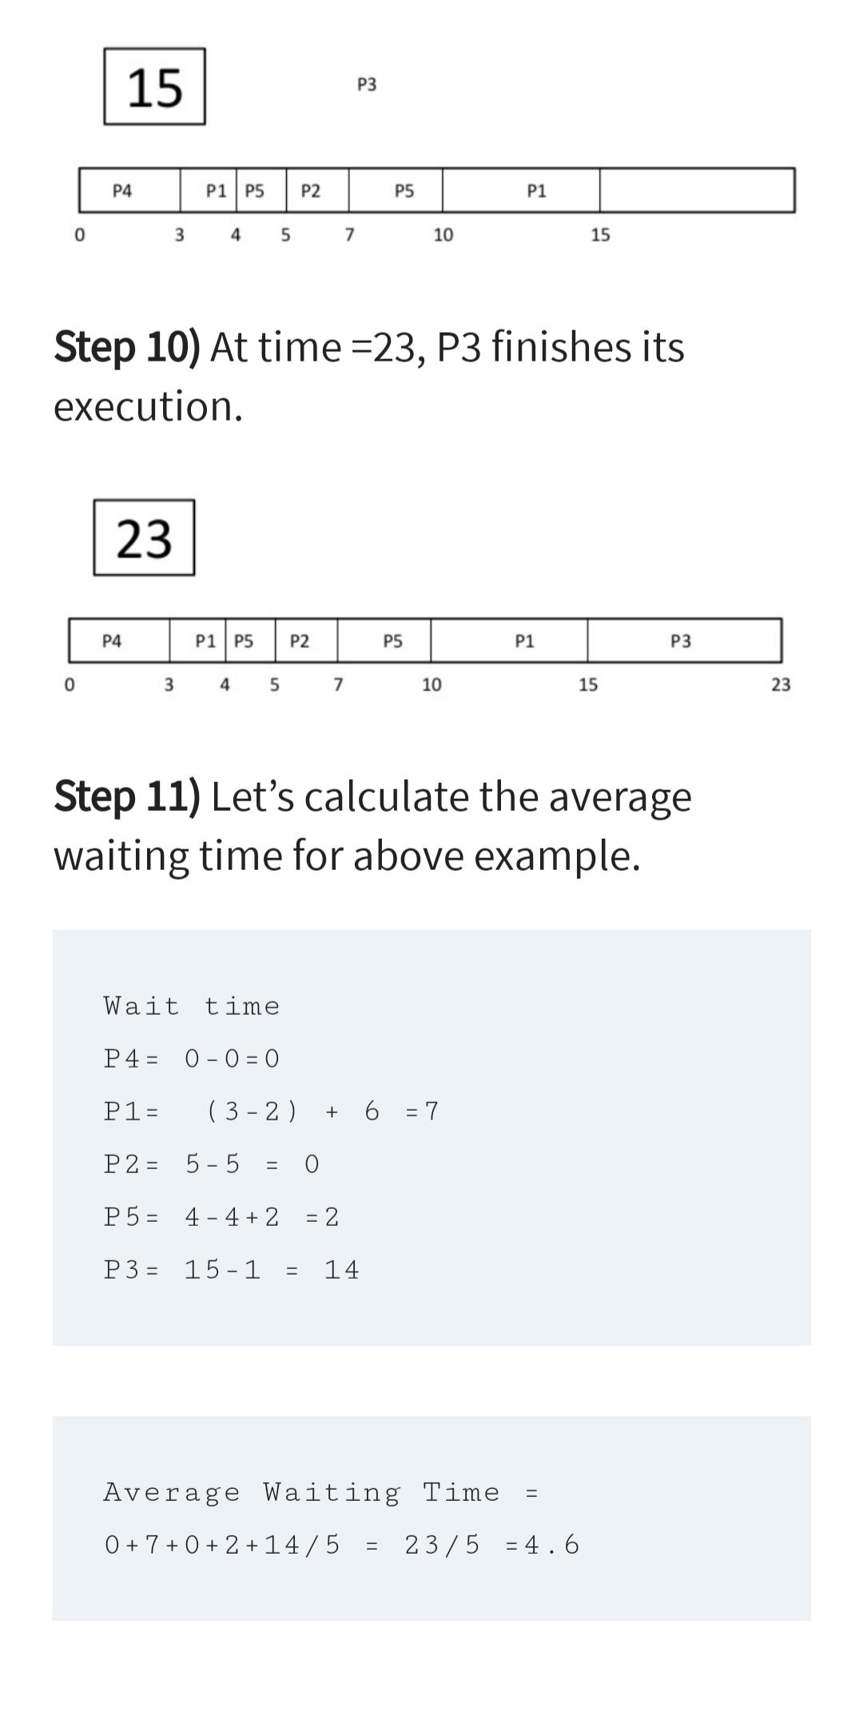

Slide 23
Sjf
Optimal Average Waiting Time
Efficient Resource Utilization
Starvation: Longer processes may suffer from starvation, where they wait indefinitely if shorter processes keep arriving.
Difficult to Implement: SJF requires precise knowledge of the duration of each process, which is not always possible or practical to obtain.

Slide 24
Priority scheduling
In Priority scheduling, there is a priority number assigned to each process.
In some systems, the lower the number, the higher the priority. While, in the others, the higher the number, the higher will be the priority.
The Process with the higher priority among the available processes is given the CPU.

Slide 25
Preemptive Priority Scheduling
The CPU is preempted if a new process arrives with a higher priority than the currently running process.
Example: If Process A is running and Process B arrives with a higher priority, Process A will be stopped, and Process B will start execution.

Slide 26
Non-Preemptive Priority Scheduling
The running process is not interrupted until it finishes its CPU burst.
Example: If Process A is running and Process B arrives with a higher priority, Process B will have to wait until Process A completes.

Slide 27
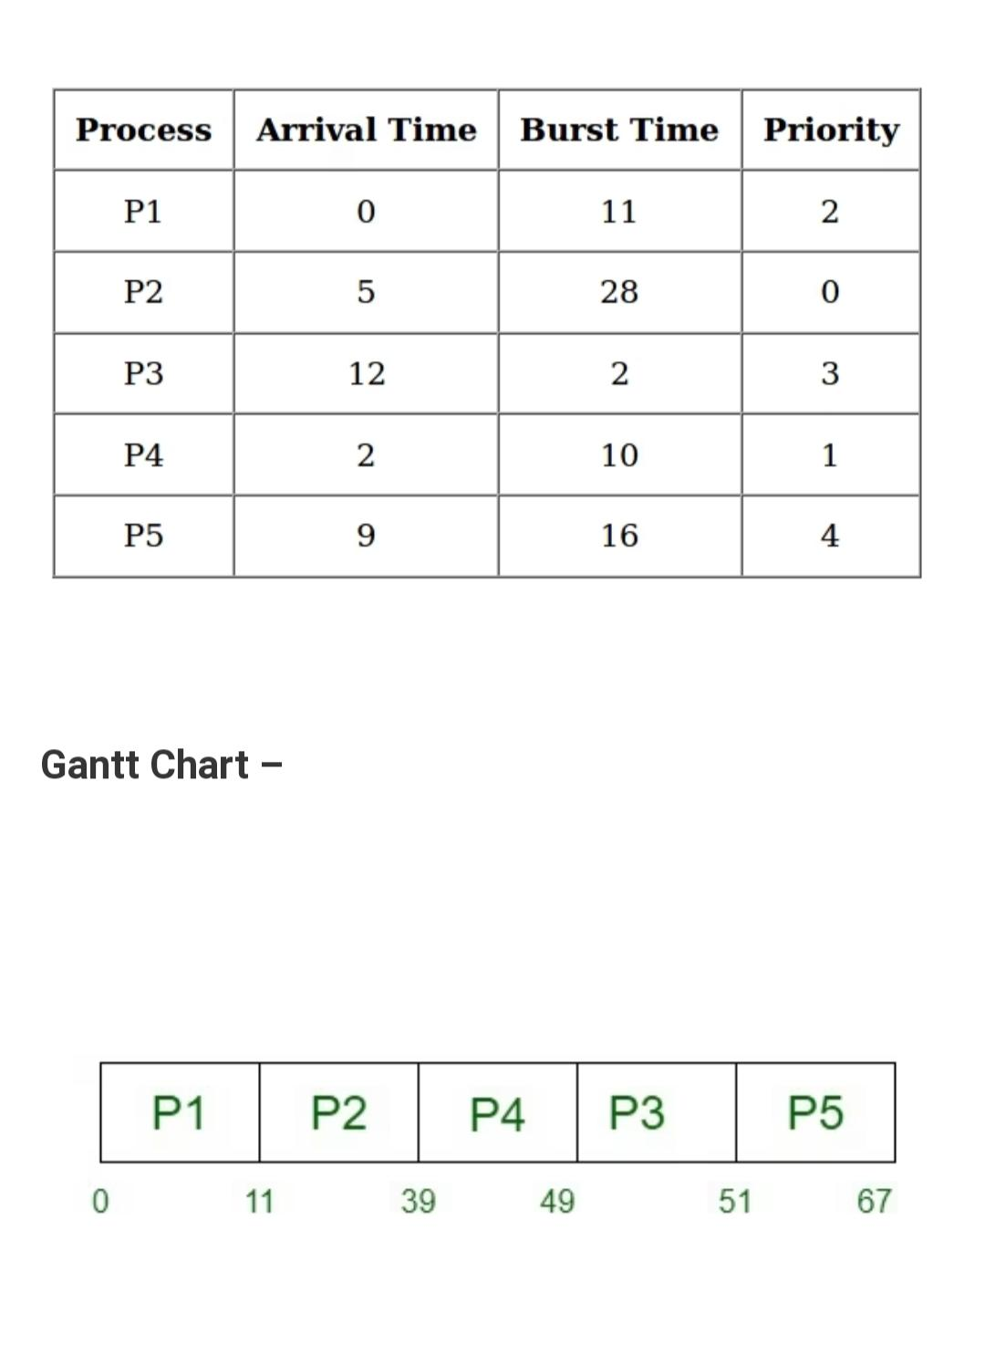
Priority scheduling – non preemptive

Slide 28
Priority scheduling – preemptive

Slide 29
Priority scheduling
Starvation: Lower-priority processes may never get executed if high-priority processes keep coming.
Complexity: Managing different priorities can be complex.

Slide 30
Round robin scheduling
Round Robin (RR) scheduling is a CPU scheduling algorithm that assigns a fixed time quantum (time slice) to each process in the queue.
The CPU scheduler cycles through the processes, giving each one a turn to execute for a set amount of time before moving on to the next process in the queue.

Slide 31
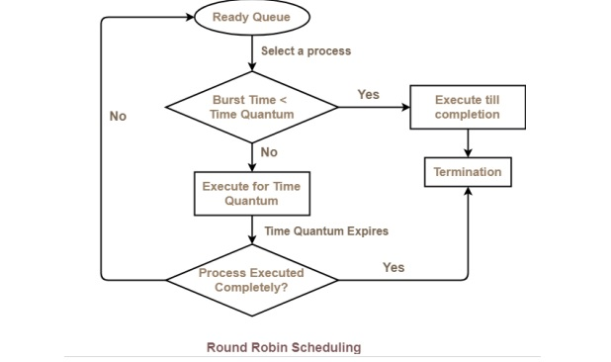
Round robin scheduling

Slide 32
Round robin scheduling
Time Quantum: A small, fixed unit of time is defined, usually between 10-100 milliseconds.
Process Execution: Each process in the queue gets to execute for a time equal to the time quantum.
Context Switching: When a process's time quantum expires, a context switch occurs, and the CPU is given to the next process in the queue.
Rotation: The process is then placed at the back of the queue if it hasn’t finished execution. This cycle continues until all processes are complete.

Slide 33
Round robin scheduling
Process ID | Arrival Time | Burst Time
P1 | 0 | 7
P2 | 1 | 4
P3 | 2 | 15
P4 | 3 | 11
P5 | 4 | 20
P6 | 4 | 9
Time slice = 5 ms

Slide 34
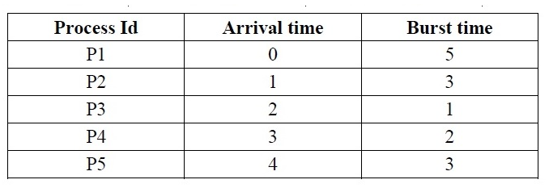
Round robin scheduling

Slide 35

